Slide 1


Practicum Presentation - 1
Apple INC
Practicum-1
Group Members
Atul Sharma (11810126)
Sandeep Kumar Singh (11810014)

Slide 2
Agenda
Executive Summary (Practicum Extract) – Word File
Business Problem
Data Requirements & Data Collections
Data Understanding
Data Preparation
Modeling, Evaluation and Feedback
Business Recommendations
Assumptions, Limitations & Further Work

Slide 3
1) Executive Summary (Abstract)
Motivation: Is apple losing the sheen? Apple’s loyal base and services used to be best in industry and due to recent events seems apple users are moving away. To understand this we want to analyse the popularity, perception and sentiment through data from various sources
Method: We have picked IphoneX which is a flagship product. To analyse we have used twitter data (tweets contain iphonex) along with data from Kaggle. Amazon Kaggle data contains review about all unlocked phones and apart from this we have used iphone review data as well. To train the model (logistics regression) we have used unlocked phone data and tested it against iphonex reviews to find the sentiment. Once done, we have populated wordcloud to find other most frequent words. Same thing (test against model and plotting the sentiment) was done with twitter data after merging and cleaning.
Models: we have used logistics regression model based on Bag of words vectorization method. For training this model we have used unlocked phones data and tested it against review data and twitter data. We found that positive perception regarding iphonex has not changed since last year (review data is from last December and twitter data from this December). People talk about other phones along with iphone but mostly for comparison.
Message: Overall with this analysis we were able to find that people have positive sentiment regarding iphone x. Popularity of apple products most specifically iphone is very good. There was a spike in Aug and Nov(4 days black Friday event). If we compare oneplus 6T against iphone X, iphone is still a winner. This trend reverses in India where iphone is not so popular against oneplus or Samsung.
Means: visualization:Matplotlib,wordcloud, Datapull: csv,xml,tweepy,numpy,pandas, modelling: scikit-learn,textblob, language: python

Slide 4
2) Business Problem
Business Understanding
Is Apple still the greatest tech company that it used to be? Investors are concerned. Is Apple’s loyal fan base diminishing in size? US market hardly gives any growth to Apple. OnePlus is dominating Apple in key emerging markets. Is there a paradigm shift in the user sentiment of Apple? How about investor sentiment? These are the question which we are trying to answer with our analysis.
Analytics Approach
1. Collection of old data related to other products including iphone. (historical trend)
2. Collection of iphonex review (product specific perception of users) and twitter data (general perception of users)
3. Training the model with historical data and test review and tweets
4. Finding the popularity of chosen products in text corpus
5. Discussion on final outcome
Solving this problem is very necessary to find out answers to above questions which could provide us a direction. If we see some deviation from past, company need to go with corrective action asap

Slide 5
3) Data Requirements & Collections
Data Requirements
We will need historical data as well as current data to find out the past and present sentiment. Also from google trends we can find the popularity change over time. For this analysis we will need some data to train the model and then we will need specific data points to test them against the model.
Data Collections
We needed twitter app keys to pull the twitter data. Also a Kaggle account to pull old data as we cannot pull old twitter data. We needed large chunk of data which was not possible from twitter as they were blocking us time to time. So we have pulled small chunks everyday and then merged them in multiple files to create a large file with all the data.
Challenges: Twitter initially denied providing us keys but soon they allowed me but for my colleague, they did not allow until he have used isb email to create a new twitter account but it was very late and we could not pull 10K records but we still managed to pull more than 7K

Slide 6
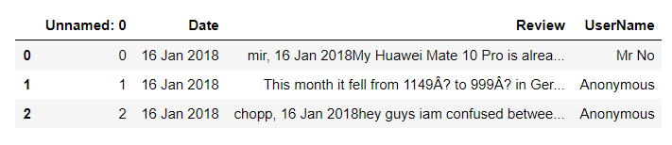
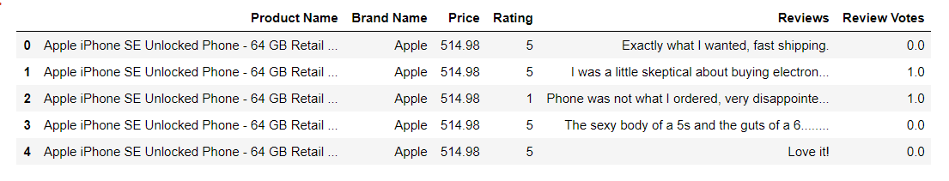
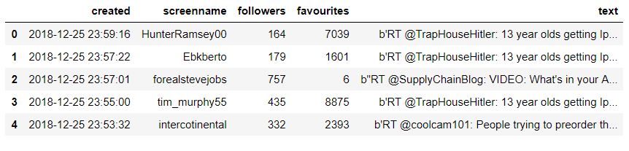
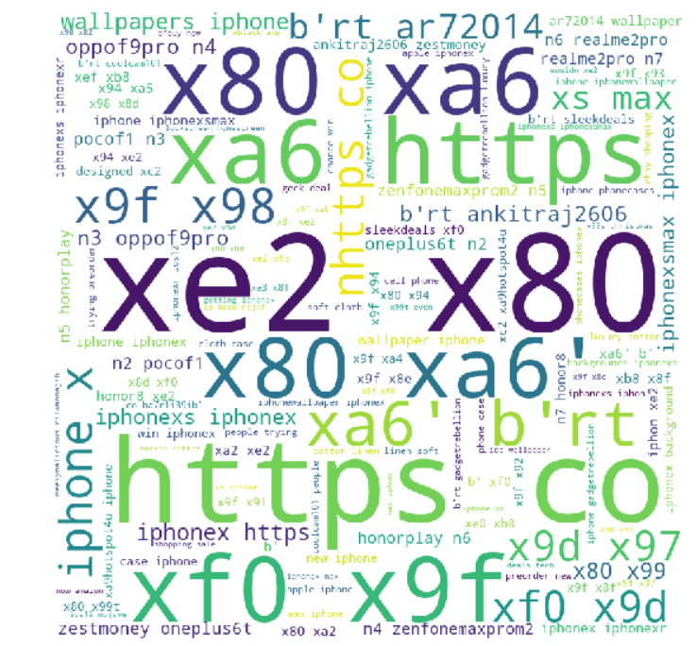
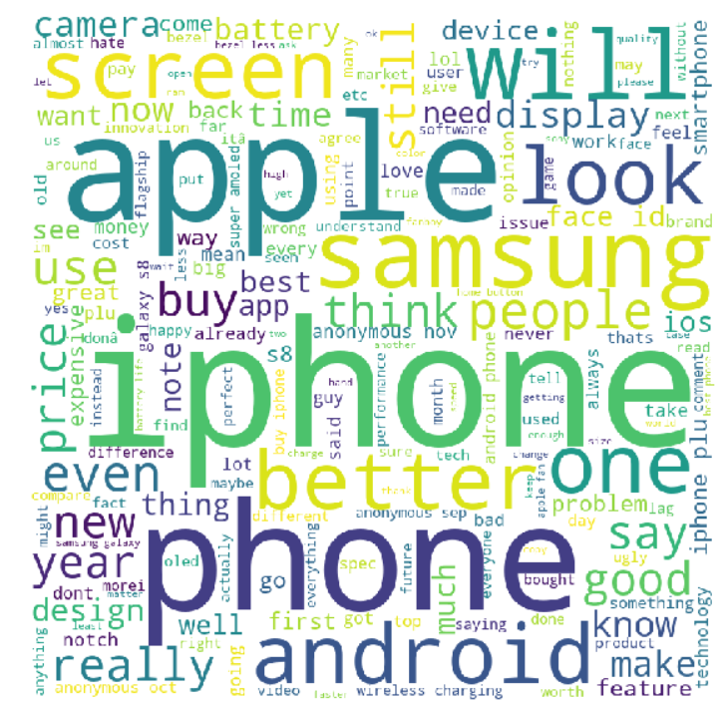
4) Data Understanding
Data Summary (left to right- iphonex review, all unlocked phones review, twitter data)
First Cut Analysis & Initial Patterns (word cloud twitter, review)

Slide 7
5) Data Preparation
Missing Value Imputations
Nosie or Outlier?
Curse of Dimensionality.
Data Normalization
Data Standardization
Deriving latent variables

Slide 8
6) Modeling, Evaluation and Feedback
What models are chosen? Why?
What Evaluation Metrics? Why?
What Optimization Techniques? Why?
What is the feedback? How did feedback change your model(s) and metric(s)?
Model Comparison (Visual, Tabular and Descriptive)
Which is the best model and why?

Slide 9
7) Business Recommendations
What is the response(s) of the model(s)?
What action items do you recommend to the business sponsors based on the response(s)?
Is the outcome quality in tune with the expectations of the business sponsor(s)? Why? Why not?
How do you propose to deploy your work?

Slide 10
8) Assumptions, Limitations & Further Works
What are the assumptions you have taken?
What are the limitations of your analysis?
What could be the further work?
Are there any inherent flaws in the approach, model or findings?

